Slide 1

6th Grade Accelerated Math
Unit 15, Lesson 4 Comparing Probabilities Volume 2, pg. 416

Slide 2


Benchmark
MA.7.DP.2.2
Given the probability of a chance event, interpret the likelihood of it occurring. Compare the probabilities of chance events.
volume 2, pg. 416

Slide 3
Integrated Mathematical Thinking and Reasoning Standards
MA.K12.MTR.3.1 Complete tasks with mathematical fluency.
MA.K12.MTR.7.1 Apply mathematics to real-world contexts.
volume 2, pg. 416

Slide 4

Learning Targets
I can interpret the likelihood of a chance event occurring using probability.
I can compare probabilities of chance events.
volume 2, pg. 416

Slide 5

Warm-Up
volume 2, pg. 417

Slide 6
15.4.1 Warm-Up: Statisticians Careers
Statisticians turn data into understandable and useful information. The government, health care industry, sports broadcasting, and many businesses have statisticians who analyze data to predict trends. Statisticians help businesses and industries with decision-making based on analysis.
What are some real-world examples where you have seen statistics used?
volume 2, pg. 417

Slide 7
Consider an industry you are interested in working in someday.
What industry are you considering?
What is at least one way you could see trends in data and analysis of statistics used in this industry?
volume 2, pg. 417

Slide 8

Activity
volume 2, pg. 417

Slide 9

15.4.2 Activity: Likelihood of Chance Events
Work with your partner or group to order the events on the cards from least likely to most likely.
After ordering the events, work with your partner or group to complete the following using the events from the card sort.
Explain which event(s), if any, can be described as “impossible.”
Explain which event(s), if any, can be described as “certain.”
volume 2, pg. 417

Slide 10
Explain which event(s), if any, can be described as “equally likely as not.
”Express the likelihood of a randomly chosen word in a novel beginning with the letter T, as a percentage.
Express the likelihood of a randomly selected person being left-handed, as a decimal.
volume 2, pg. 417

Slide 11

Guided Practice
volume 2, pg. 418

Slide 12

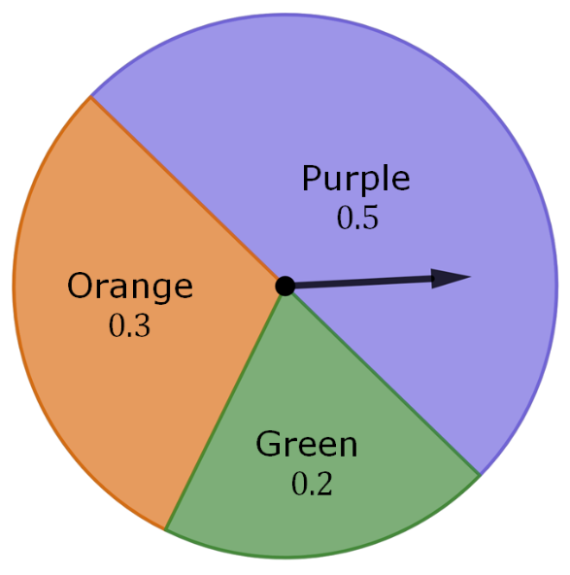
15.4.3 Guided Practice: Interpreting and Comparing Probabilities
A spinner is shown with the probabilities of landing on each space given as a decimal.
Use the spinner to complete the table by identifying the missing events, probabilities, and descriptions of likelihood.
volume 2, pg. 418

Slide 13
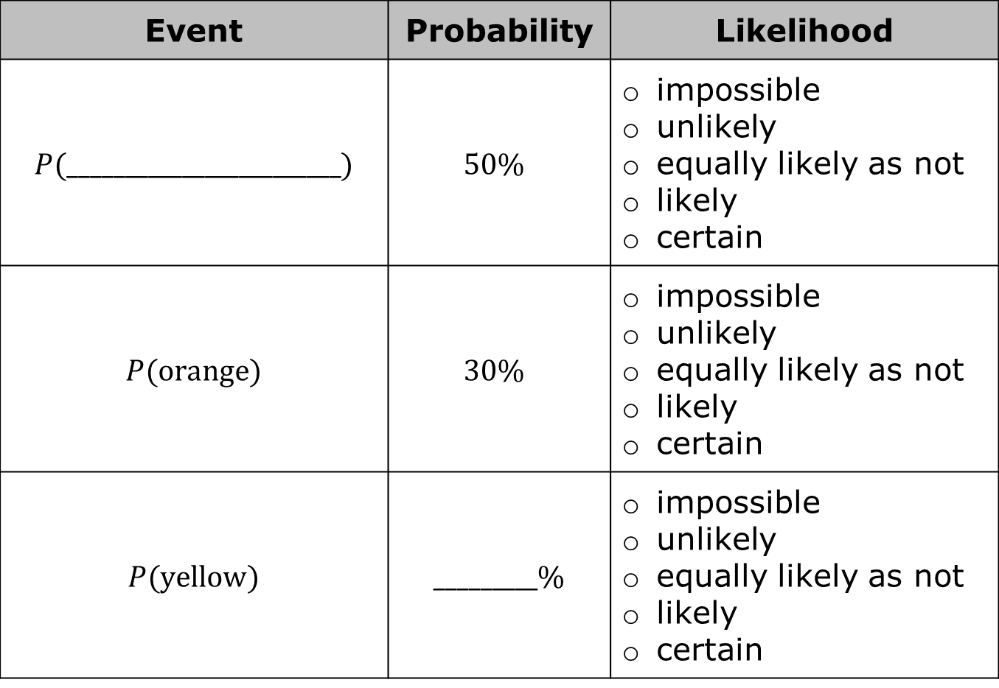
Event | Probability | Likelihood
$P$(________________________) | $$50\%$$ | impossible unlikely equally likely as not likely certain
$P$(orange) | $$30\%$$ | impossible unlikely equally likely as not likely certain
$P$(yellow) | _________% | impossible unlikely equally likely as not likely certain
volume 2, pg. 418

Slide 14

Event | Probability | Likelihood
$P$(________________________) | $$20\%$$ | impossible unlikely equally likely as not likely certain
$P$(purple or orange) | $$80\%$$ | impossible unlikely equally likely as not likely certain
$P$(color) | _________% | impossible unlikely equally likely as not likely certain
volume 2, pg. 418

Slide 15
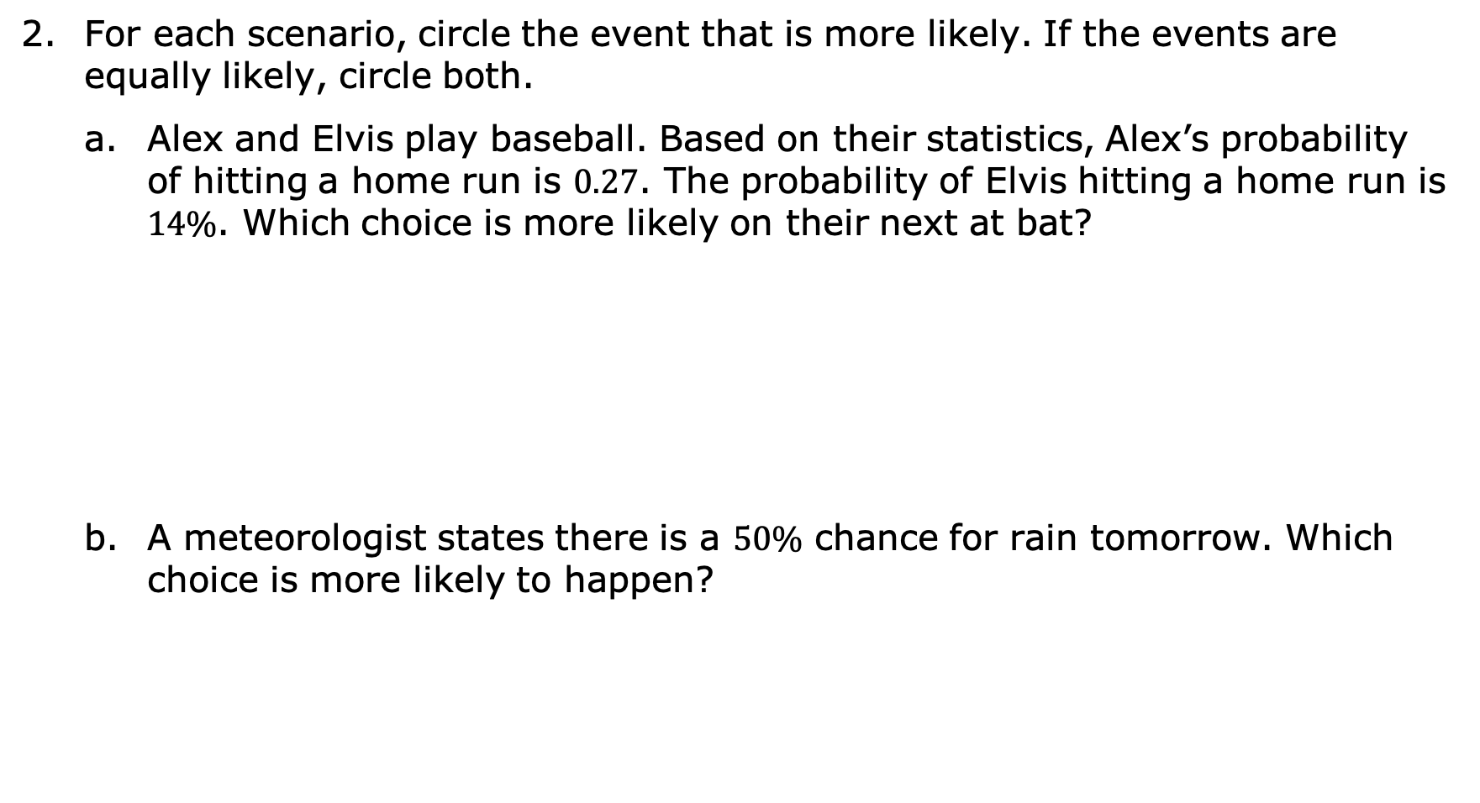
For each scenario, circle the event that is more likely. If the events are equally likely, circle both.
Alex and Elvis play baseball. Based on their statistics, Alex’s probability of hitting a home run is $0.27$. The probability of Elvis hitting a home run is $14\%$. Which choice is more likely on their next at bat?
A meteorologist states there is a $50\%$ chance for rain tomorrow. Which choice is more likely to happen?
Alex hits a home run. | or | Elvis hits a home run.
It will rain tomorrow. | or | It will not rain tomorrow.
volume 2, pg. 419

Slide 16
Shawn is calling the coin toss before his football game. Which choice is more likely to occur?
The coin will land on its edge. | or | The coin will land on either heads or tails.
volume 2, pg. 419

Slide 17

Your Turn
volume 2, pg. 419

Slide 18
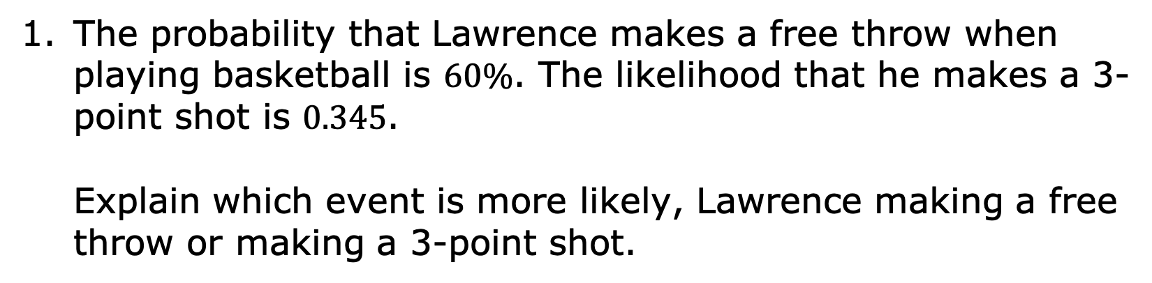
15.4.4 Your Turn!
The probability that Lawrence makes a free throw when playing basketball is $60\%$. The likelihood that he makes a 3-point shot is $0.345$.
Explain which event is more likely, Lawrence making a free throw or making a 3-point shot.
volume 2, pg. 419

Slide 19
Explain which event is more likely, Lawrence making a free throw or making a 3-point shot.
List the probabilities in order from least to greatest.
$$60\%$$ | $8$ out of $10$ | $$0.37$$ | $$20\%$$ | $\frac{5}{6}$
volume 2, pg. 419

Slide 20

Wrap-Up
volume 2, pg. 420

Slide 21
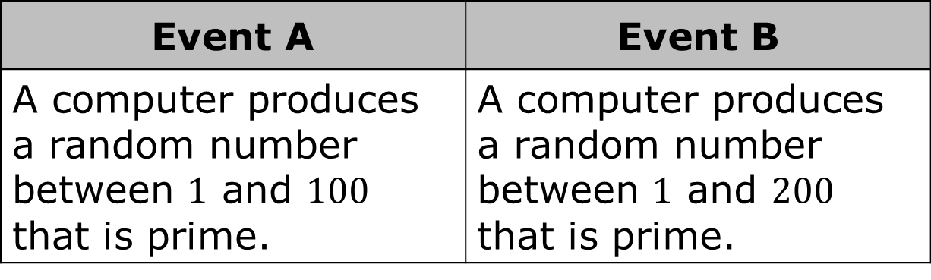
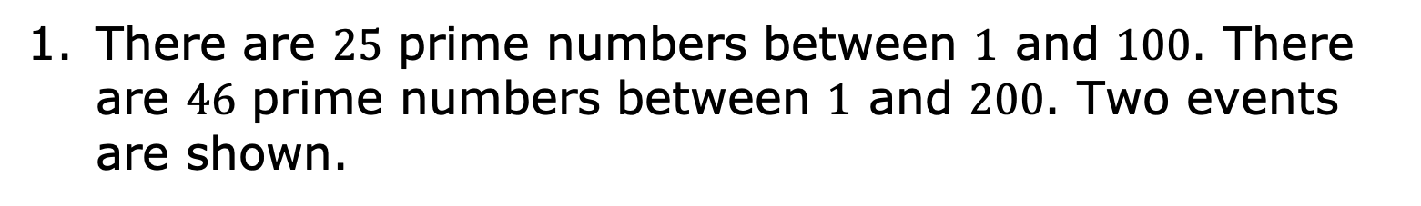
15.4.5 Wrap-Up: Ticket Out the Door
There are $25$ prime numbers between $1$ and $100$. There are $46$ prime numbers between $1$ and $200$. Two events are shown.
Event A | Event B
A computer produces a random number between $1$ and $100$ that is prime. | A computer produces a random number between $1$ and $200$ that is prime.
volume 2, pg. 420

Slide 22
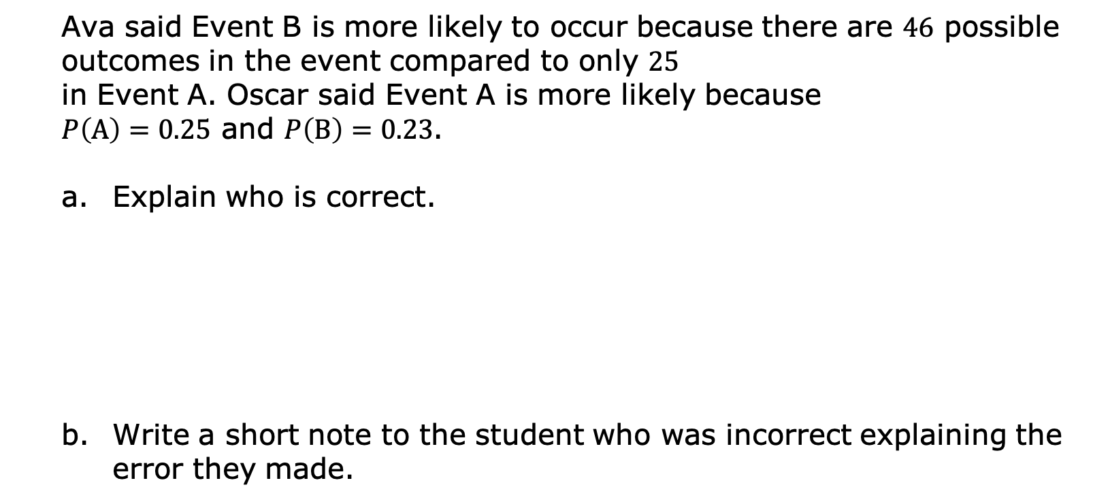
Ava said Event B is more likely to occur because there are $46$ possible outcomes in the event compared to only $25$ in Event A. Oscar said Event A is more likely because $P\left(A\right)=0.25$ and $P\left(B\right)=0.23$.
Explain who is correct.
Write a short note to the student who was incorrect explaining the error they made.
volume 2, pg. 420

